Slide 1
  3. Chemical production methods
Chemical reduction includes a variety of chemical reactions by which metallic compounds are reduced to elemental metal powders. A common process involves liberation of metals from their oxides by use of reducing agents such as hydrogen or carbon monoxide.
The reducing agent is made to combine with the oxygen in the compound to free the metallic element. This approach is used to produce powders of iron, tungsten, and copper.
Another chemical process for iron powders involves the decomposition of iron pentacarbonyl (Fe(Co)5) to produce spherical particles of high purity. Powders produced by this method are illustrated in the photomicrograph of Figure below.

Slide 2
General principles of the reduction of metals oxides by hydrogen include the following:
1. A higher temperature and longer reduction time results in a formation of larger particles with a smaller specific surface and a lower content of residual oxygen. Sintering of powder material may occur.
2. A lower temperature and shorter reduction time results in a formation of small particles with a larger specific surface and a higher content of residual oxygen. A formation of pyrophoric powder may occur.
3. A high hydrogen flow rate with a low dew-point results in high reduction rate, low content of residual oxygen and preventing re-oxidation of reduced powder during cooling-down.

Slide 3
Figure (1): Iron powders produced by decomposition of iron pentacarbonyl; particle sizes range from about 0.25 to 3.0 mm (10–125 m-in). (Photo courtesy of GAF Chemicals Corporation, Advanced Materials Division.)

Slide 4
Example for chemical reduction method
Reduction of iron oxides
Reduction processes are used to produce more than one half of the world production of iron powder for powder metallurgy applications. The input raw materials for its manufacture are iron oxides which are used especially in a form of ores or scales. They are usually reduced using solid (coke, furnace black) or gaseous (CO, CH4…) reducing agents.
When using a solid reducing agent – carbon, reduction by means of a vapour phase occurs after the initial reaction between the solid phases (oxide-carbon):
MeO + CO « Me + CO2
Except this main reaction, side reactions, such as carburization of iron, formation of Fe3C carbides, etc. can occur, however, they are insignificant for the particular reduction processes.
As a matter of fact, when reducing Fe3O4 using CO at temperatures < 650 °C, no reaction between Fe3O4 and CO occurs. Also, on the ground of the temperature dependence of the reaction
CO2 + C « CO

Slide 5
  4. Electrochemical production methods
Approximately 60 metals can be successfully obtained via electrolysis, where electric current acts as a reducing agent: An electrolyte can be a solution or a molten salt conducting the current as a result of presence of ions.
Electrolysis from water solutions is used to make powder metals not having too high affinity for oxygen as Cu, Fe and Ni. Highly reactive powders (e.g. Be, Ta, Nb, Th ,...), which form highly stable oxides, have to be segregated from molten salts by electrolysis.
From the point of view of powder metallurgy, tantalum making from molten salts is of a great significance.

Slide 6
While electrolysis from water solutions takes place at slightly elevated temperatures (to 60 °C), electrolysis from molten salts requires quite high temperatures depending on the melting point of an applicable (binary or ternary) salt eutecticum, which has to contain an appropriate concentration of the metal to be segregated.
In a simple event, electrolysis runs on two electrodes connected to direct current, where an anode is made of metal the ions of which are in the solution. When electric current passes across, the metal on the anode (positive electrode) becomes dissolved and on the cathode (negative electrode) becomes segregated. During electrolysis a migration of positive ions (cations) to the negative electrode (cathode) and negative ions (anions) to the positive electrode occurs (Fig. 2).

Slide 7
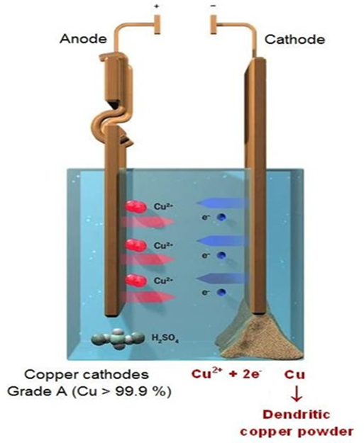
Figure (2) Electrolysis principle

Slide 8
Reduction takes place on the cathode – electropositive components are segregated (metals, hydrogen); oxidation takes place on the anode – electronegative components are segregated.
The lowest voltage which has to be imposed on the electrodes, so that continuous electric current can pass across and electrolysis can run, is called the decomposition voltage.
The basic characteristics of powders made using electrolysis is their high purity and a dendritic or sponge structure, good compressibility, high strength of non-sintered compacts and high activity at sintering

Slide 9
However, the following disadvantages are connected with the process of the manufacture of powders using electrolysis:
- the process requires to refine the electrolyte from residual impurities, in particular from salt residues after the fusible electrolysis
- high cost of electric power
- only the manufacture of elementary powders is of a practical significance
- the resulting product has to be cleaned and disintegrated, which means extra costs. Main parameters affecting a dimension, shape and structure of particles:
    current density;
    metal ion concentration;
    electrolyte conductivity;
    temperature;
    bath circulation;
    in special cases an addition of surface-active substances to constraint the growth of nuclei.

